Slide 1
Home Automation System
Making Life Easy

Slide 2
Outline
Introduction
Light Automation System
Why we select this project ?
Hardware Requirements
Software Requirements
Detailed Network Architecture
Detailed Project Flow Chart
ER Diagram
Project Implementation
Usage of codes / commands
Features
Challenges
Testing
Results

Slide 3


Introduction
Home Automation is very useful system which allows the owners to control all the appliances of their house with the help of smartphone.
The another name of home automation system is smart home system.
There are various uses of home automation system like control the temperature, control the lights, entertainment system and other appliances.
It is also good for safety perspective and makes good use of technology. It can send the notification to smartphone if there is anyone at door.
In this project, we are basically working on light automation project. The light automation is the main part of home automation system.

Slide 4
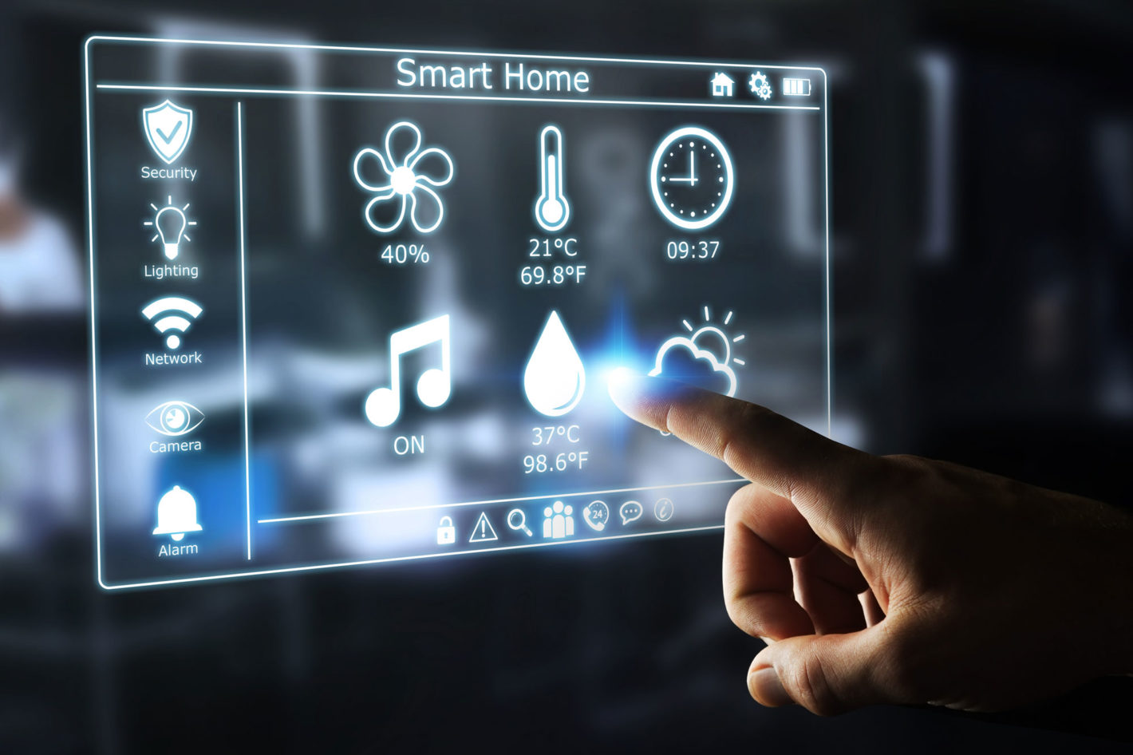
Light Automation System
Light Automation is a system which can change the state of lights with smartphone.
In this project, I am using raspberry pi, relay, telegram and python programming language.
A client can send the commands to lights with the help of telegram application.
Just A system That Makes Life Easy And Productive!

Slide 5
Why we select this project ?
The light Automation systems are very expensive these days. So, it is very hard for
middle class people to afford these systems.
The main aim of my project is to make a cost-effective light automation system
which can be affordable for everyone.
Another purpose of this project is to try to help the handicapped people.
For example: Its very hard for handicapped people to turn On/Off the lights
of their house because the switches are located at different corners of house.
But with the help of this system, they can control all the lights of their house
with their smartphone.

Slide 6
Hardware Necessities
While making a system both hardware and software are very important. Because without the use of the hardware it is not possible to make a system.
There are different types of hardware which I used while making a system.
a) Raspberry Pi:- Raspberry Pi is a small credit size computer that can do everything which we expect from a computer to do.
b) Relay:- Relay is an electronically operated switch. It can open and close the circuit electromechanically and electronically.
c) Lamp:- As we all know, lamp is a very small equipment which ranges from radio waves to gamma waves.
d) Jumper wires:- I used jumper wires to connect the raspberry with relay.

Slide 7
Hardware Necessities
e) SD card:- I also used SD card to download and install the Raspbian OS on Raspberry Pi .
f) Power supplier:- It is power supplier of Raspberry Pi which is used to turn on the
Raspberry Pi.
g) Power cable:- It is used to supply current to circuit.
h) Smart phone:- Smartphone is used to send the commands to Raspberry Pi.

Slide 8
Software Necessities
To complete this project, I used two main software:-
A) Python:- Python is the high level programming language which I used to do the programming in raspberry Pi
B) Telegram:- Telegram is a type of messenger app which is based on cloud and I use it to send the commands to lights.

Slide 9
Detailed Network Architecture
The user need a good quality of Wi Fi to start this system.
The user will send the commands from his smartphone with the help of telegram application.
The Raspberry will receive the commands from smartphone with the help of Wi Fi technology.
The Raspberry Pi will change the state of Relay.
Relay will Turn On/Off the lamp according to the commands of user.

Slide 10
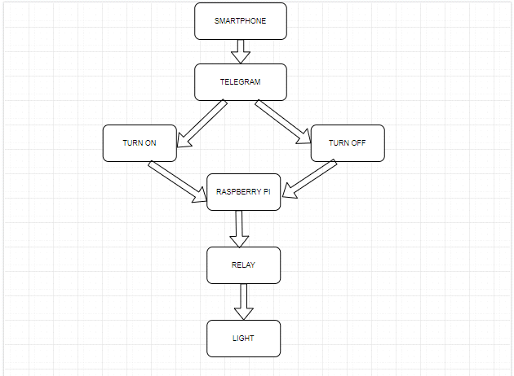
Detailed Project Flow Chart
This framework of the system needs a smartphone with high speed of internet.
Telegram sends the data to Raspberry Pi.
Raspberry works as small computer which can be controlled by USB, by plugging in the console and interfacing it to monitor.
Raspberry Pi will send the same data to relay and relay will change the state of light according to data provided by Raspberry Pi.

Slide 11
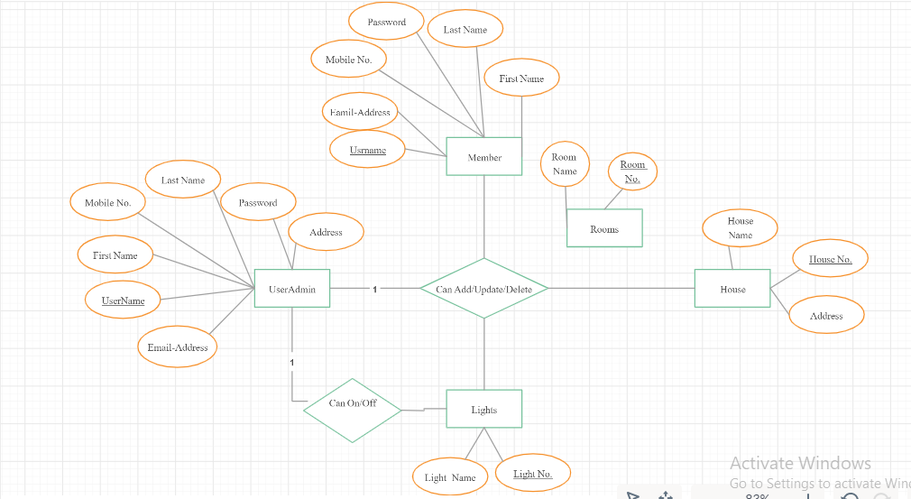
ER Diagram
This system is based on IOT which means
an owner can easily access all the lights
using smartphone.
With the help of use case diagram, it is very
easy to understand the working of this system.
This system can include various users by
doing small changes in system.
The admin can add, remove or change the
user.
The owner can use password for security
and can change it anytime.

Slide 12
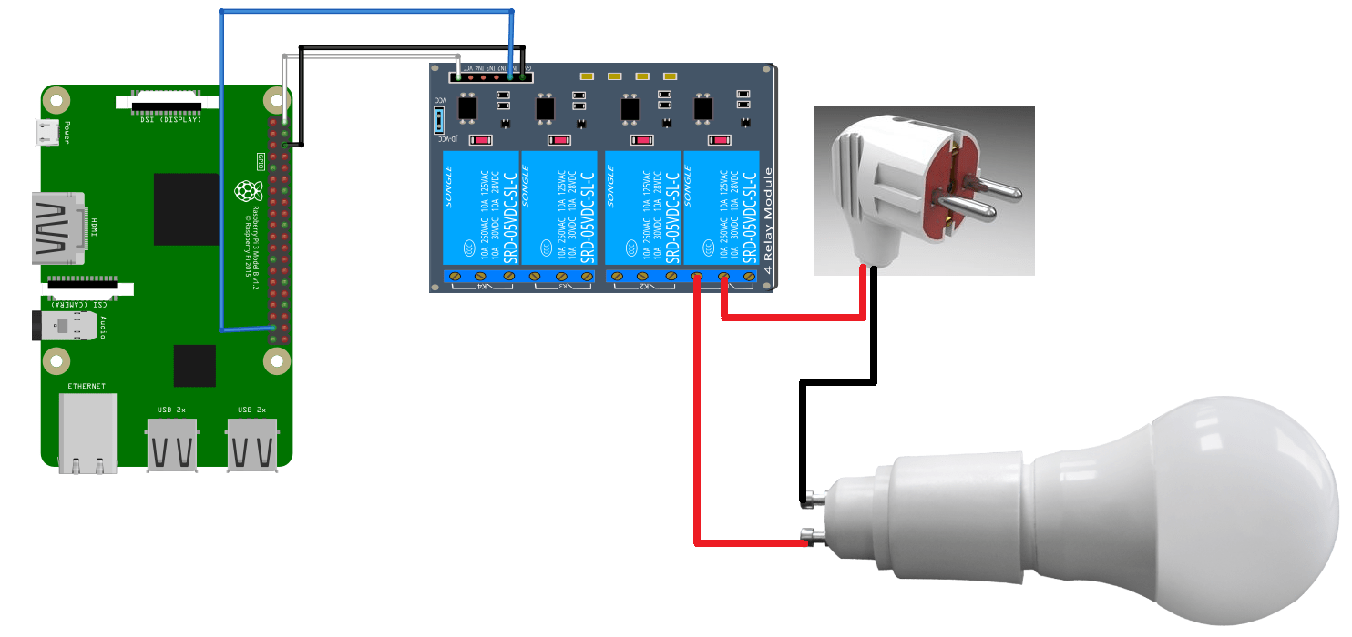
Project Implementation
Circuit Diagram

Slide 13
Implementation steps
In first step, I connect the raspberry Pi with monitor, mouse and keyboard.
After that I download the Raspbian Operating system and install it on raspberry Pi.
In third step, I install the telegram app and create a BotFather and get the token
number.
Now, Install python and complete the programing for this project.
Connect Raspberry Pi with telegram app using token number.
Connect Raspberry Pi with relay using jumper wires.
In last step, connect the lamp with relay.

Slide 14
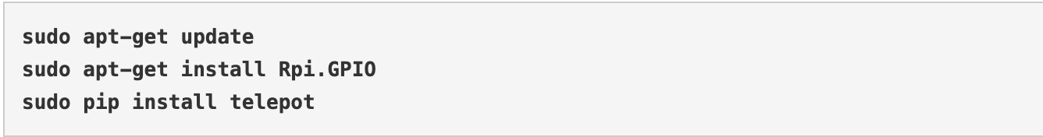
Usage of codes / commands
This below screenshot is the programming install the different libraries which was used
in this project.

Slide 15
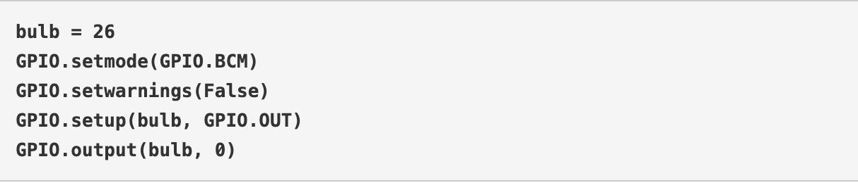
Usage of codes / commands
In this project, we set GPIO pin 26 as output pin to change the state of the relay.
Initially the relay is set at “0” state to keep the lamp in Off state

Slide 16
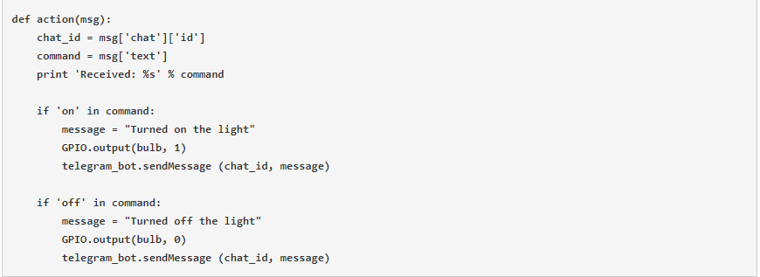
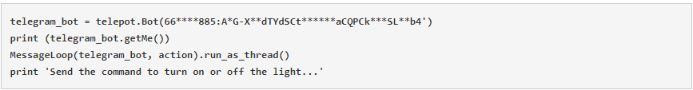
Usage of codes / commands
These are the screenshots of programming which we do in python.
The first screenshot of programming is used to change the state of lamp according to the commands.
In second screenshot of programming is used to connect the telegram with Raspberry Pi.

Slide 17
Features
Remote access- In this project, I am using the remote system to control the
lights of the house even when we are not at home.
Energy management :- The light automation project save the lot of time and energy
of client by turning On/Off the light of his house with the help of smartphone.
Software update- A client can upgrade the software with his smartphone without any
help of expert .
Comfort- This light automation project is very comfortable for client. It makes the
house comfortable and easy to use the lights of house

Slide 18
Challenges
Reliability:- To make a successful home automation project, designers need to address
contemplations regarding the reliability of reasonable devices as compared to old devices.
Security:- The security of light automation system is a main challenge for developers.
Hacking is a main problem in these days. Most of the hackers try to steal the data and
misuse that data
Connectivity:-The right connectivity of devices is a main challenge in this light automation
project. By mistake if anyone connect the wrong wires and wrong devices there are
chances of blast of lights and can also fuse all the lights of house at same time.
Budgeting:-Its very hard to select the hardware according to the budget of the project which I can use
to make a light automation system. Most of the hardware used in the light automation
project is expensive so it’s a big challenge for me to make the cost
effective system which is profitable for client and seller.

Slide 19
Testing
Testing is the most important part of every system.
To complete the testing of this system, connect all the hardware according to the given circuit diagram (slide13).
Open the terminal of Raspberry Pi and open the python programming file.
After that, send the commands from telegram. If the Raspberry Pi is receiving commands, it means our whole project is working.

Slide 20
Results
I connected all the devices and after that I configure the raspberry pi with relay. These all devices work properly and now all the devices can send and receive the commands.
Wi Fi technology is used to send commands and it works properly but for that I need good speed of the internet if internet is slow then there is a delay to send and receive the signal.

Slide 21
Results
The control process used the command turned on the light or turned off the light. But we have to make sure we use the right commands for turning on or turning off the light which we given in the python file.
After getting all the things right we discovered one thing that is delay between the commands, when we send command from smartphone through TELEGRAM app, there is a delay process of 5 seconds to 10 seconds, this all depends on speed of the internet.
https://youtu.be/33x-Nb7AUuw

Slide 22
Thank You

